Slide 1
Personal Blog post Manager
Angular, Node, Mongo, Express

Slide 2
What is my case study ?
Blog manager using single page application by angular
CRUD operations using Node and Mongo as backend/database
Components used are login, register, post-list, post-create, header.
Services used are post-service
Modules used are angular material, forms, http client
Backend routes is post.js and server.js

Slide 3
How to start my project
Download the project from github
Go to the directory and install npm dependences using npm I -–force
Ng serve –-port 1000
Node server.js to start the server
Access the frontend using localhost:1000
To see the api or test it go to localhost:3000/api/posts
Send requests using postman
The requests used are post, put, delete, get.

Slide 4
Components and there functions
Post model has id, title, content, and image source
Data is created with post create and displayed by post list
Data is traveled between postcreate -> post service -> backend -> postlist
Under post we have
Post service
Post create
Post model data type
Post list

Slide 5
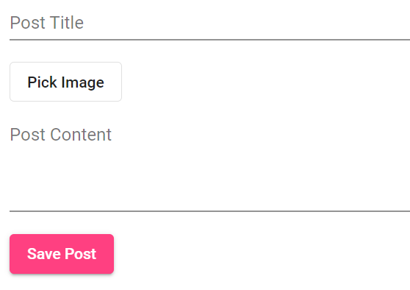
Example of sample data set
export interface Post {
id: string;
(auto generated by mongo)
title: string;
content: string;
imagePath: string;}

Slide 6
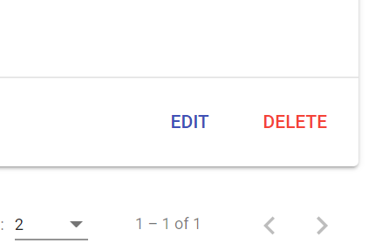
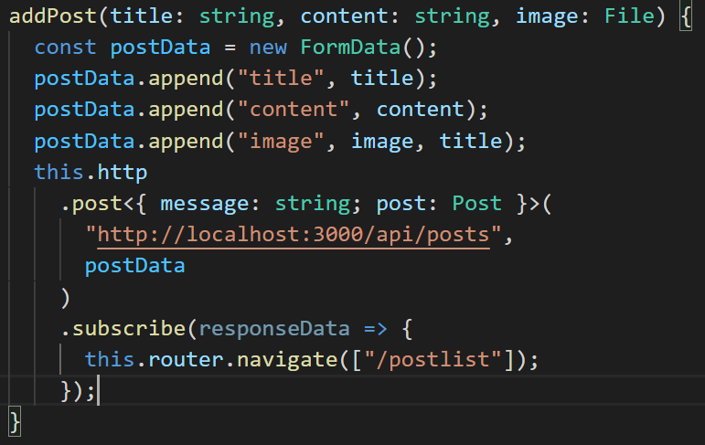
Edit & delete
The edit is done using put and delete is done using the delete request
The post processing through post_service component

Slide 7
Thank You
-Lohitasya Tata

